Slide 1




Slide 2

Download the slides
http://theleanprogrammer.com/aam/5

Slide 3

What are we going to learn today?
React Router
React Portals

Slide 4

Let’s see a live demo
http://madhavbahl.tech/portfolio/

Slide 5
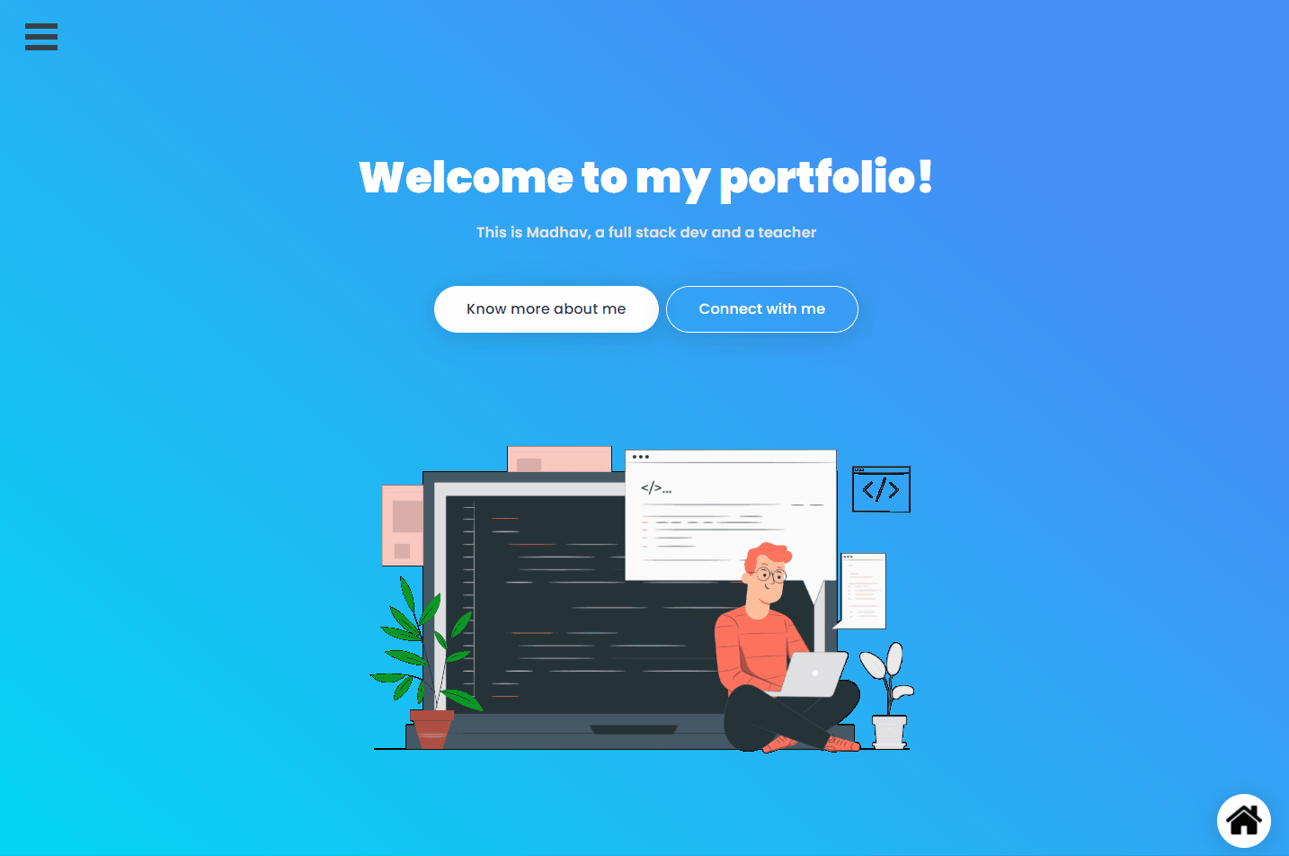

Slide 6
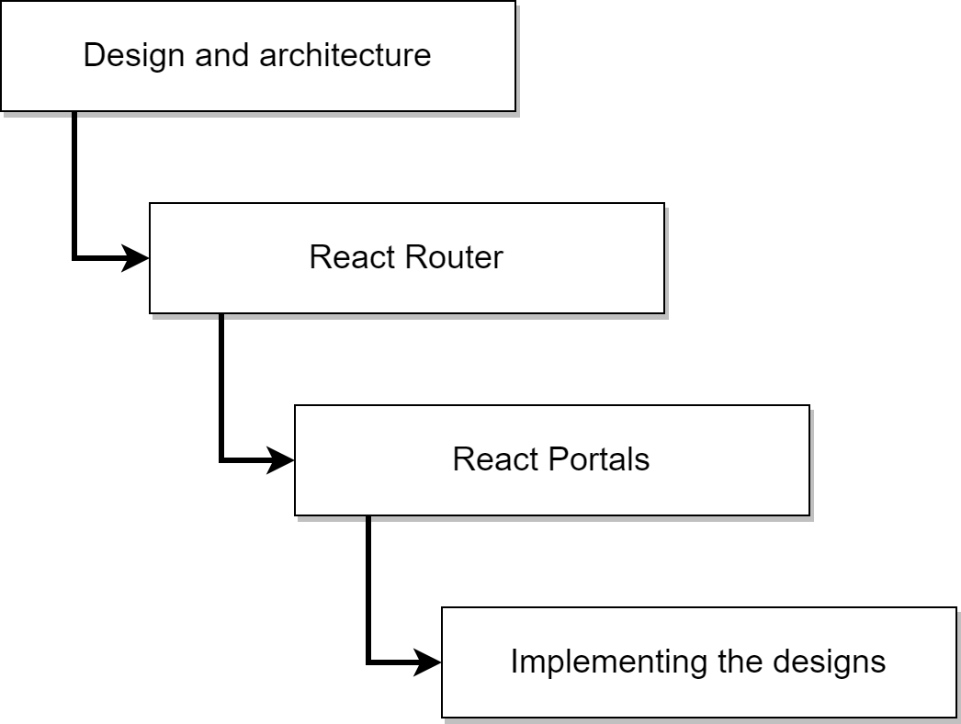
Our flow for today

Slide 7
Section 1: understanding the wireframes and architecture

Slide 8
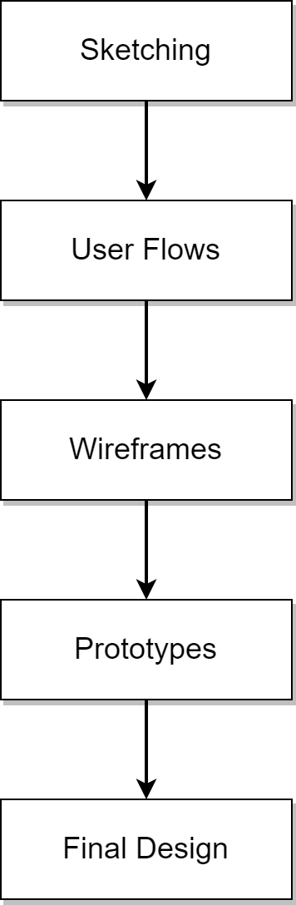
Various phases in design

Slide 9
List of pages
Home page
About page
Projects page
Skills page
Contact me page

Slide 10
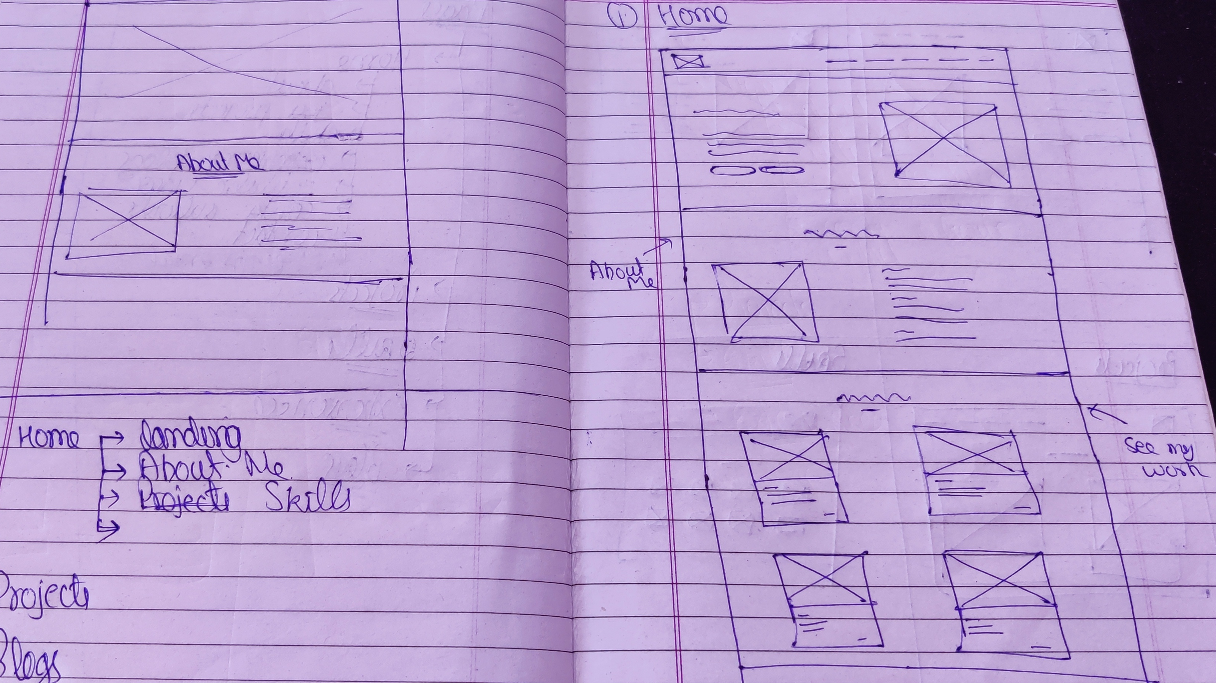
Sketch

Slide 11
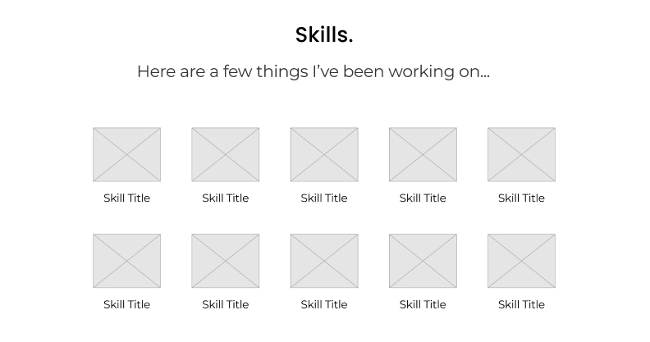
Understanding the wireframes

Slide 12
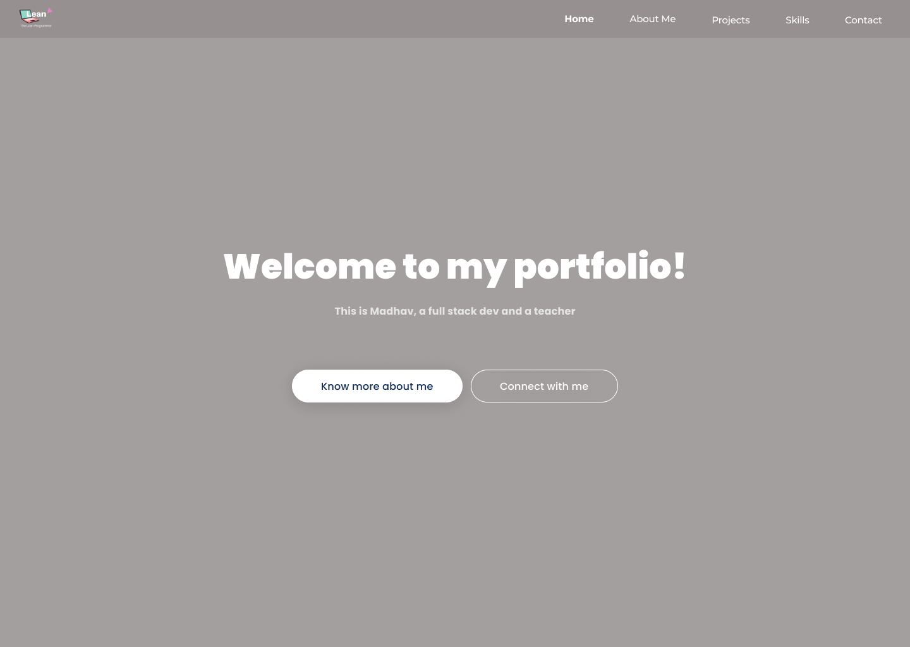
home

Slide 13
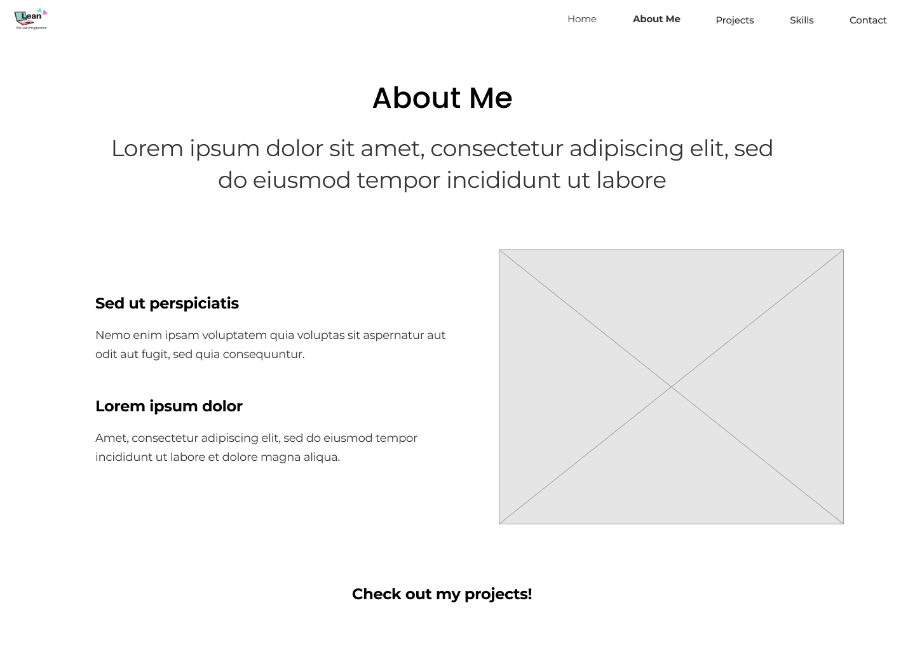
about

Slide 14
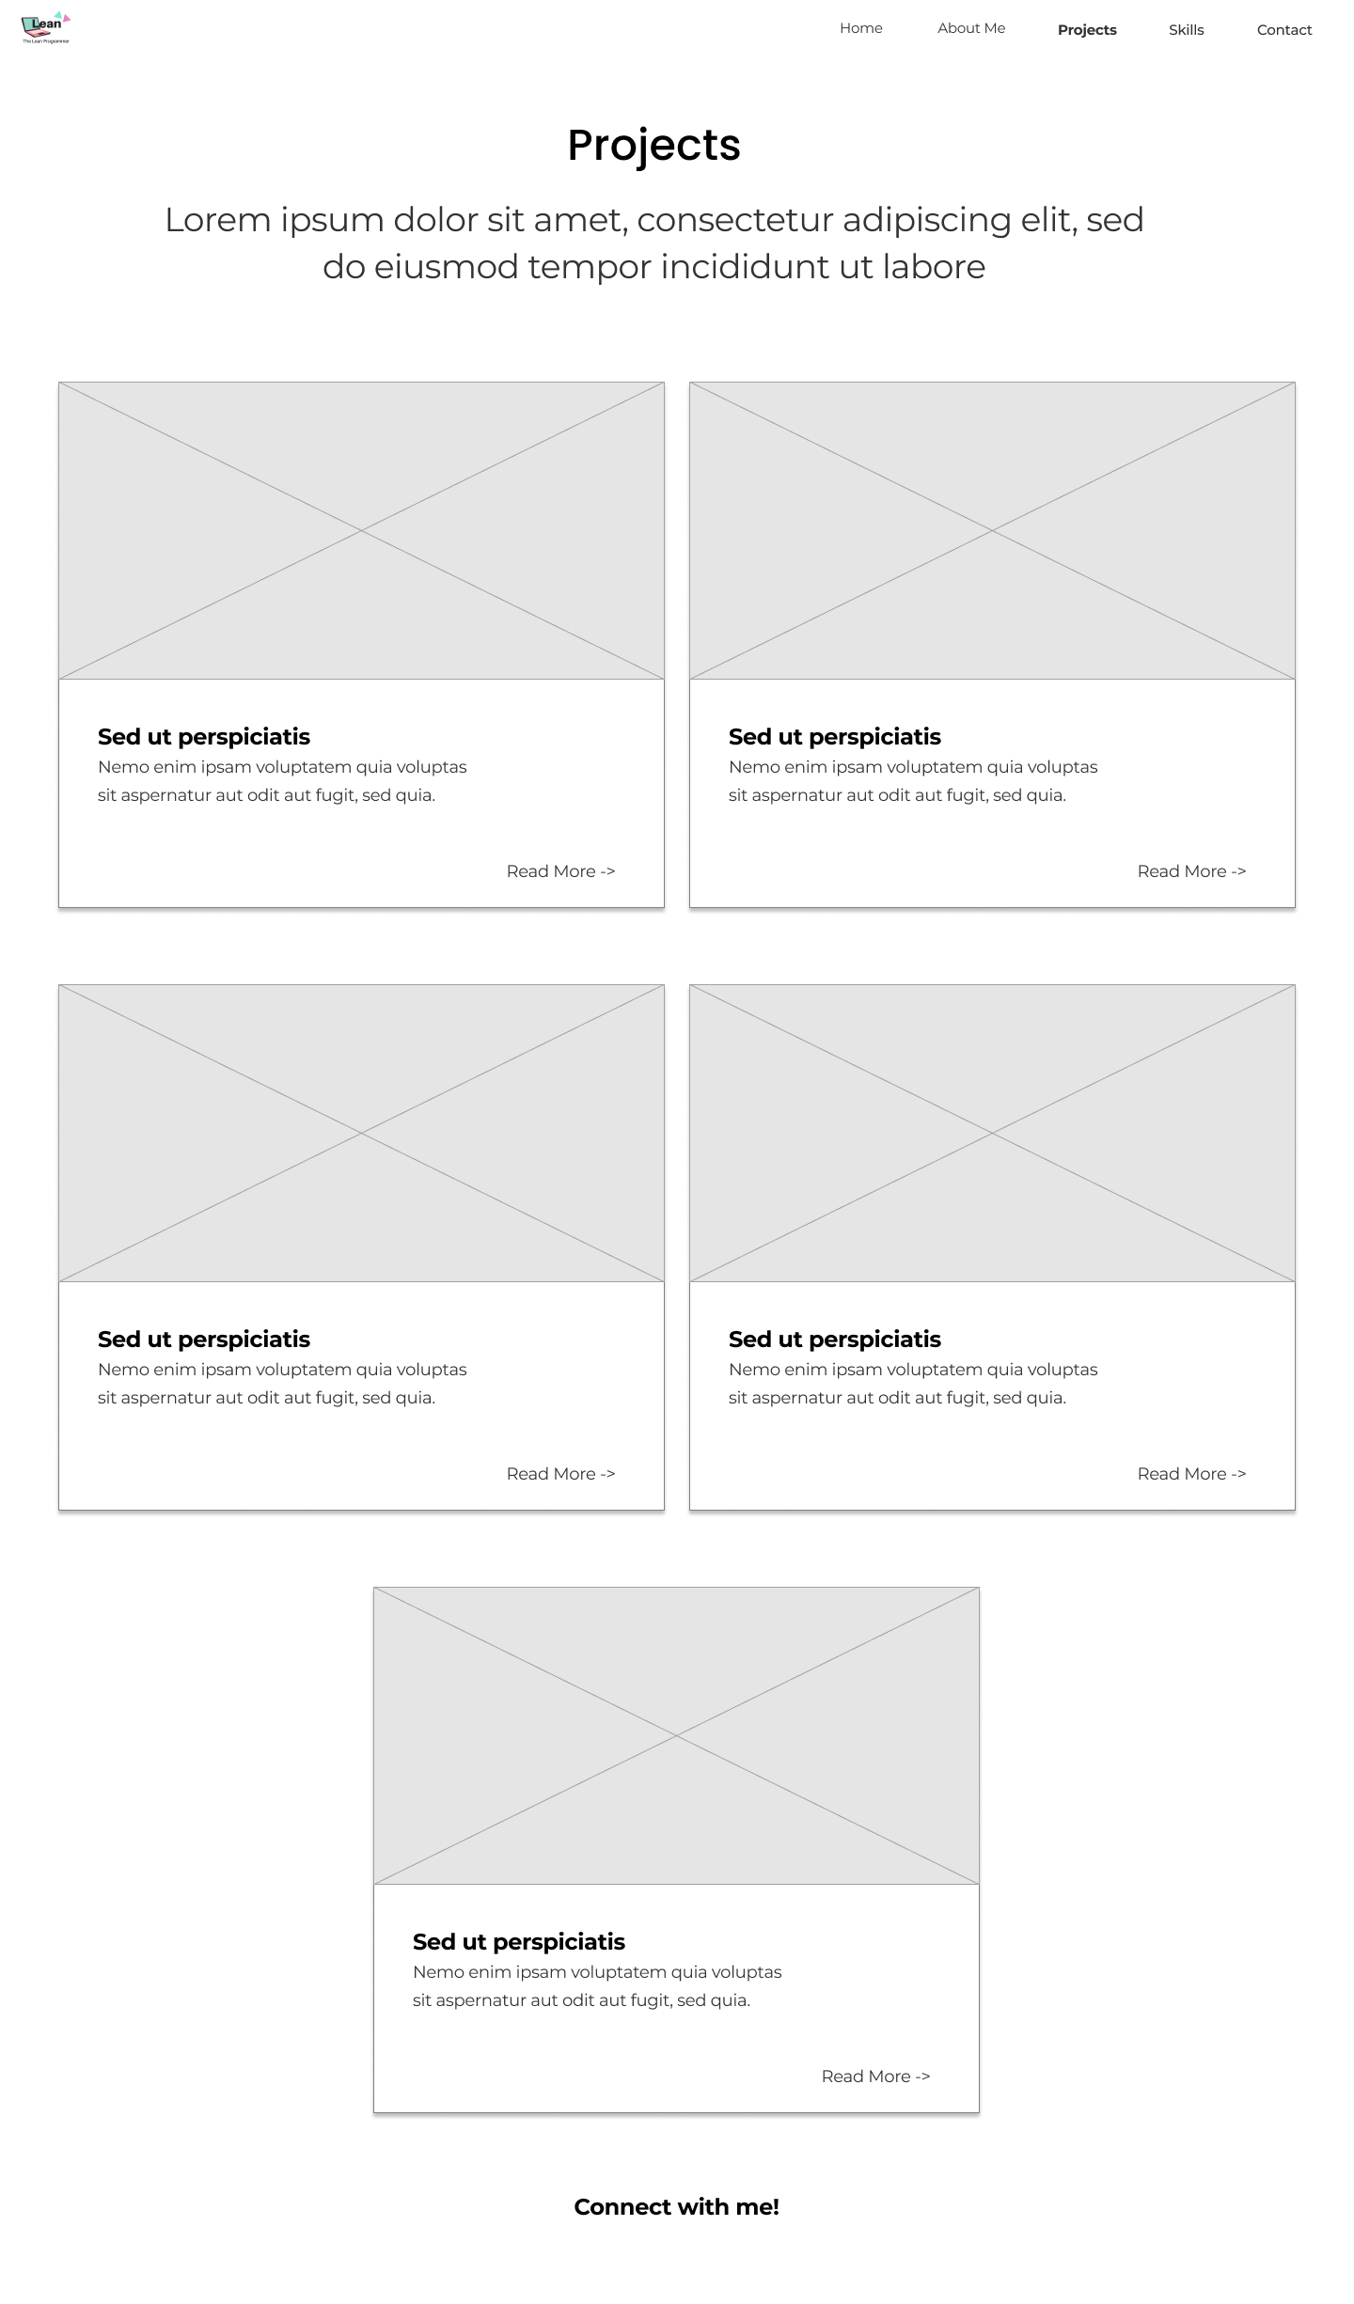
projects

Slide 15
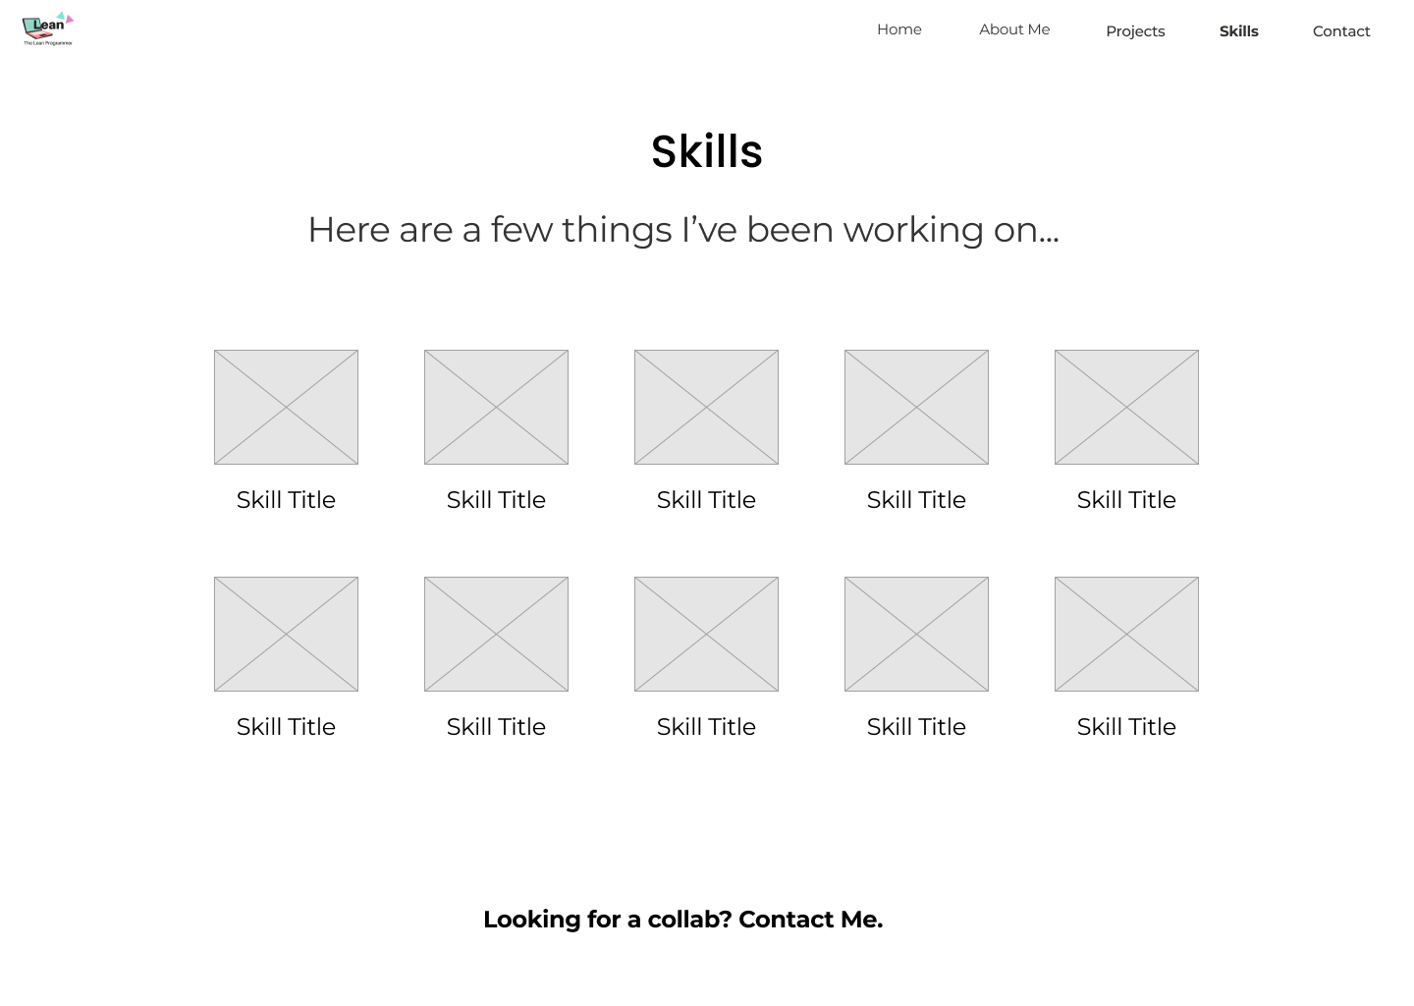
skills

Slide 16
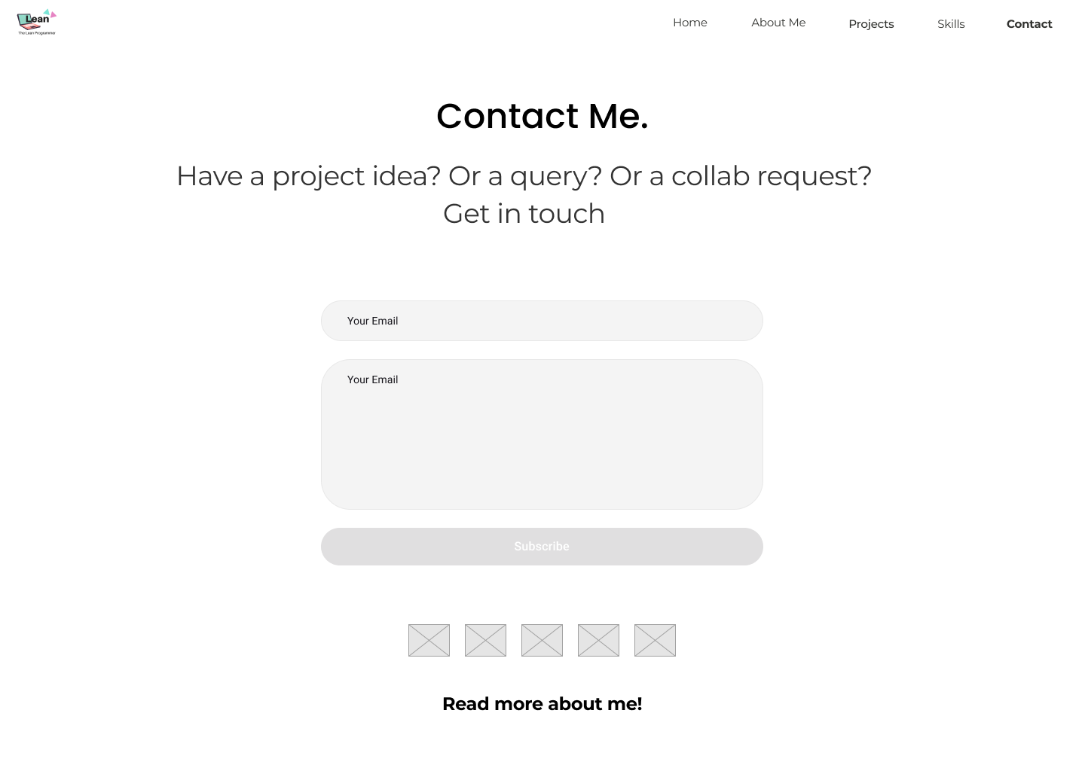
contact

Slide 17
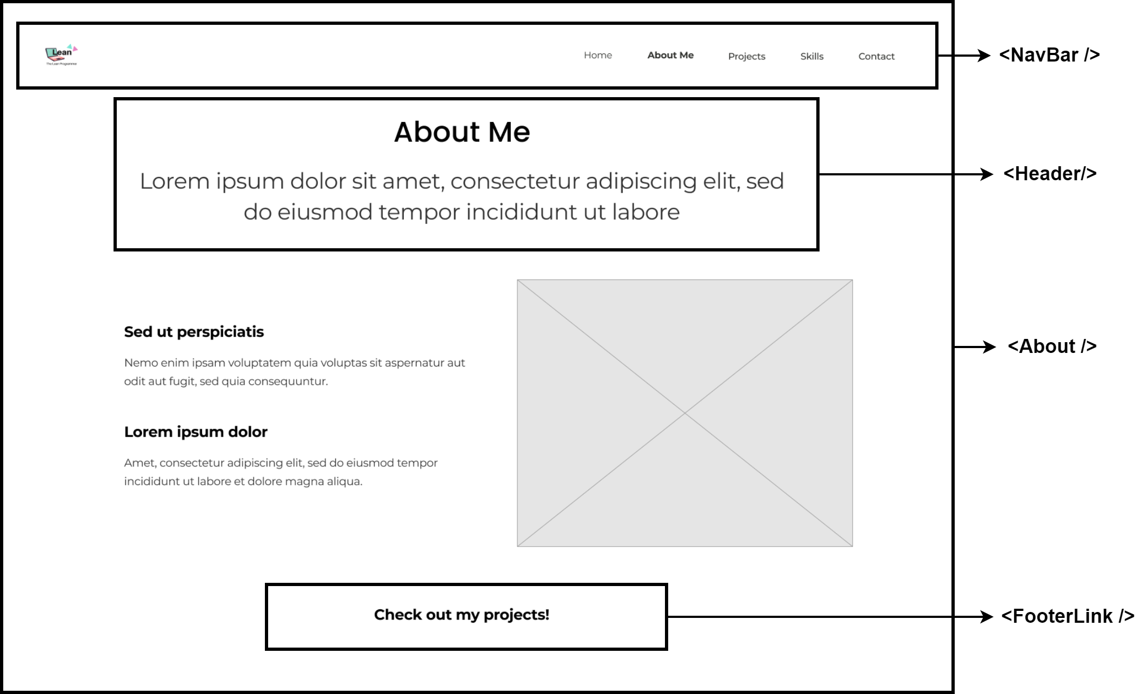
Let’s finalize the react components!

Slide 18
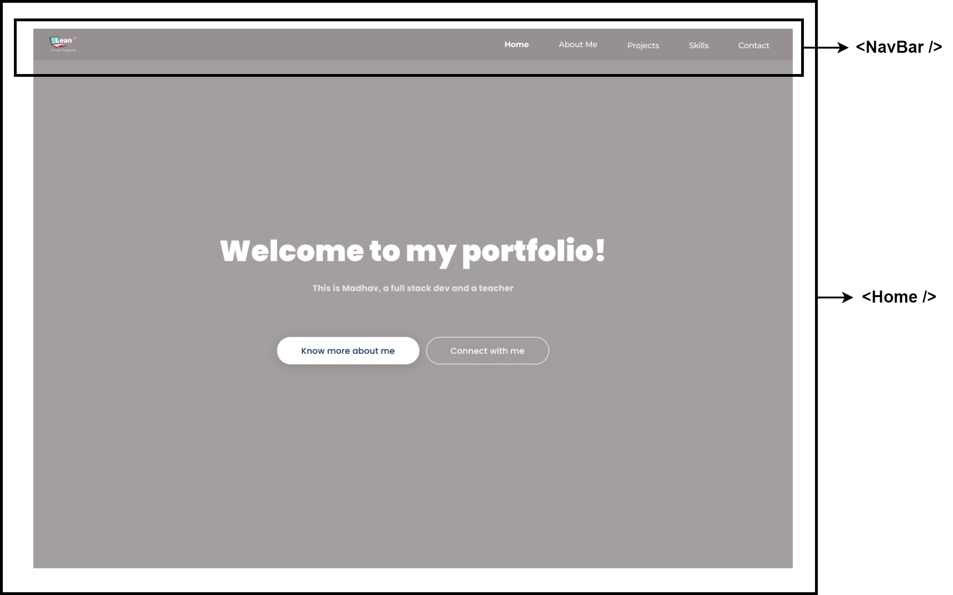
HOME

Slide 19
about

Slide 20
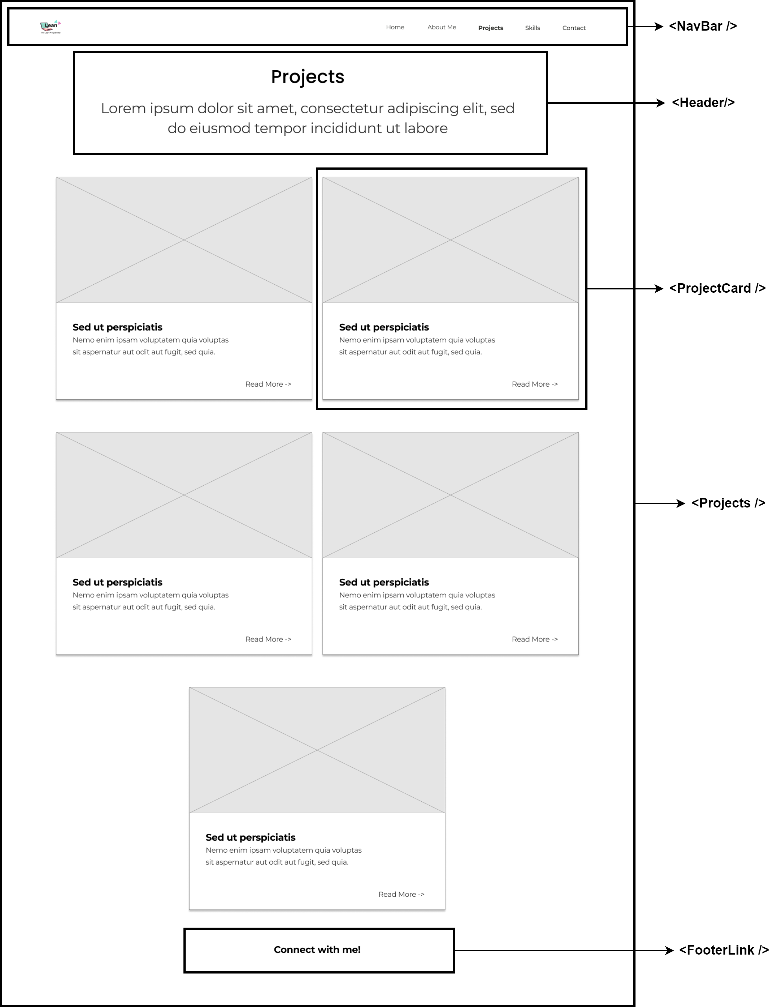
Projects

Slide 21
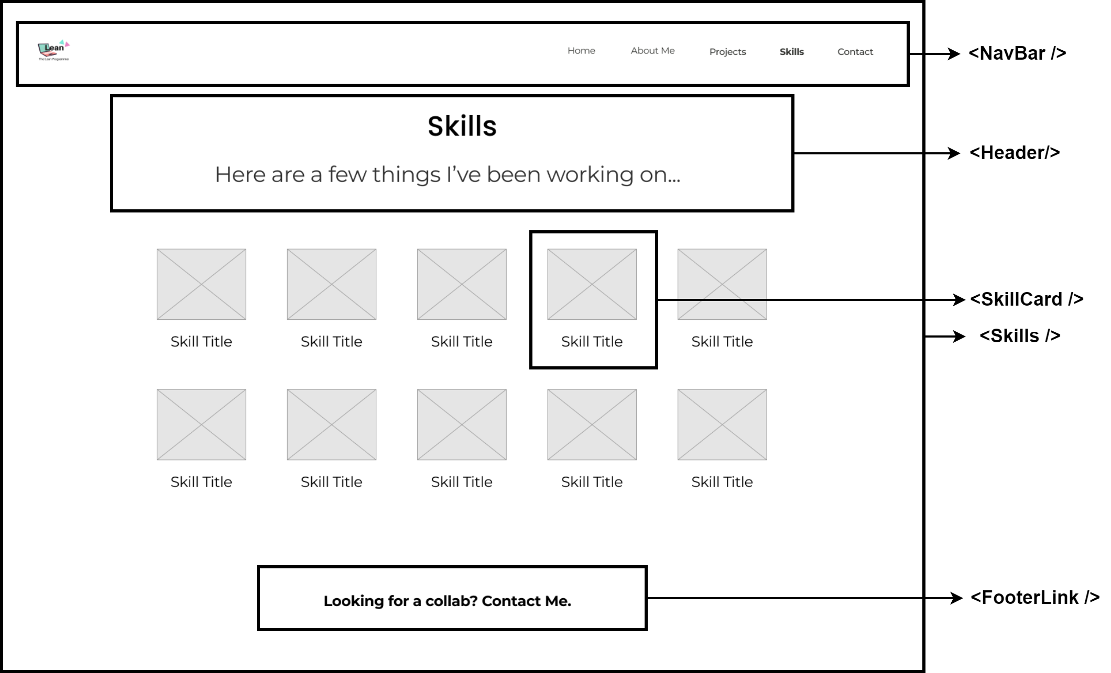
skills

Slide 22
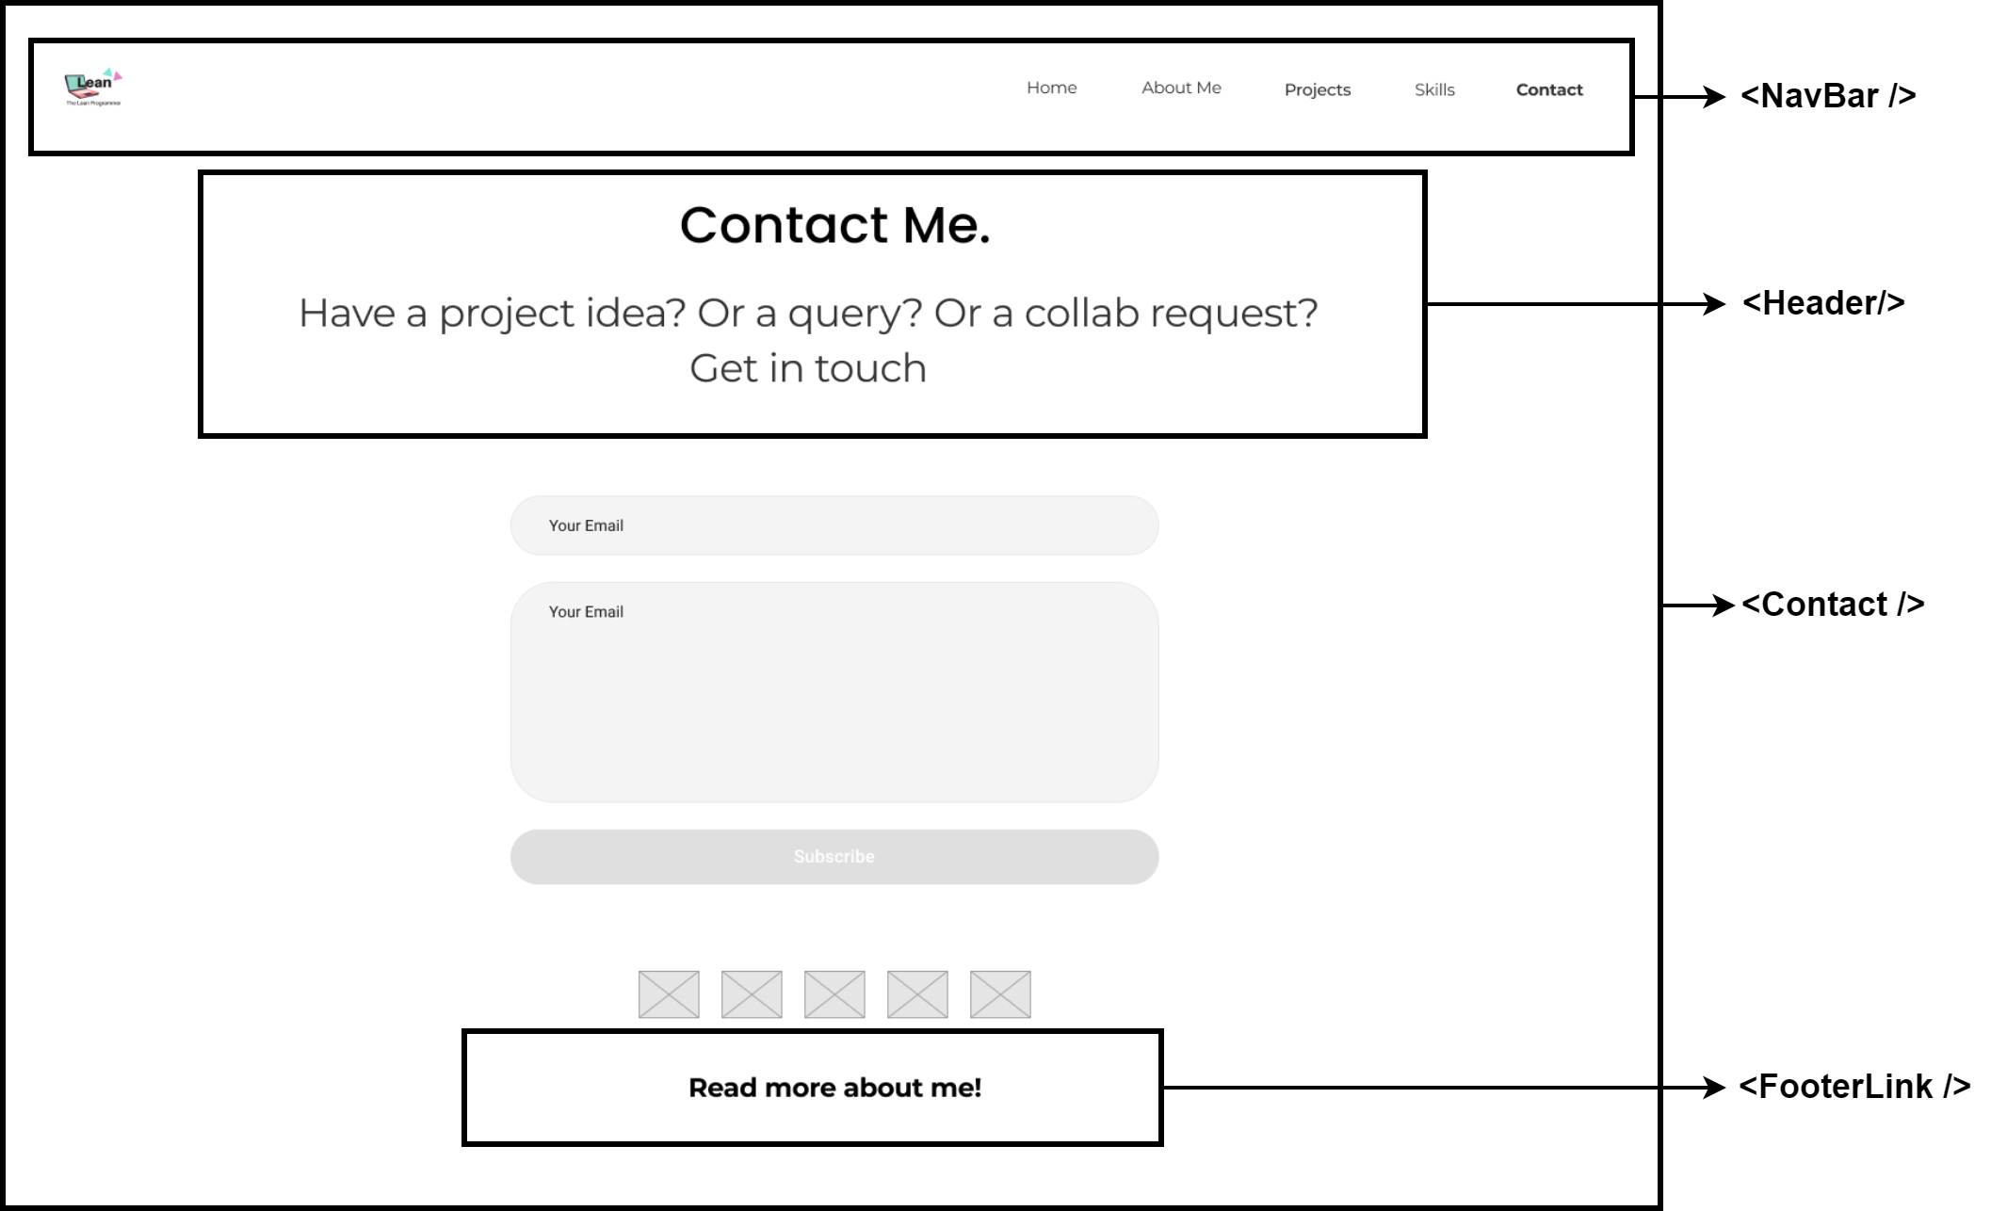
contact

Slide 23
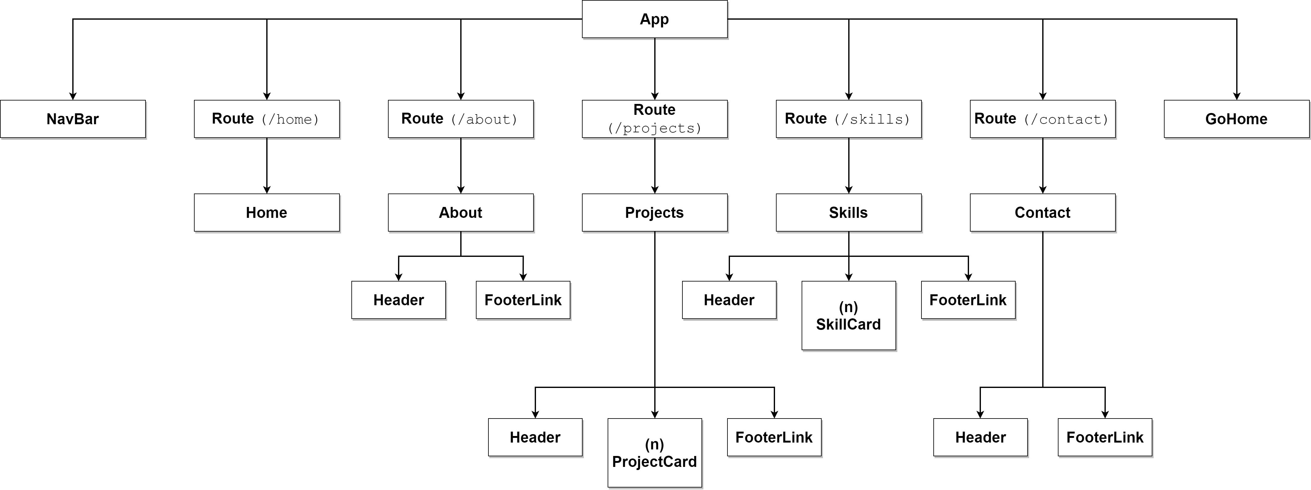
Component architecture

Slide 25
Final designs

Slide 26
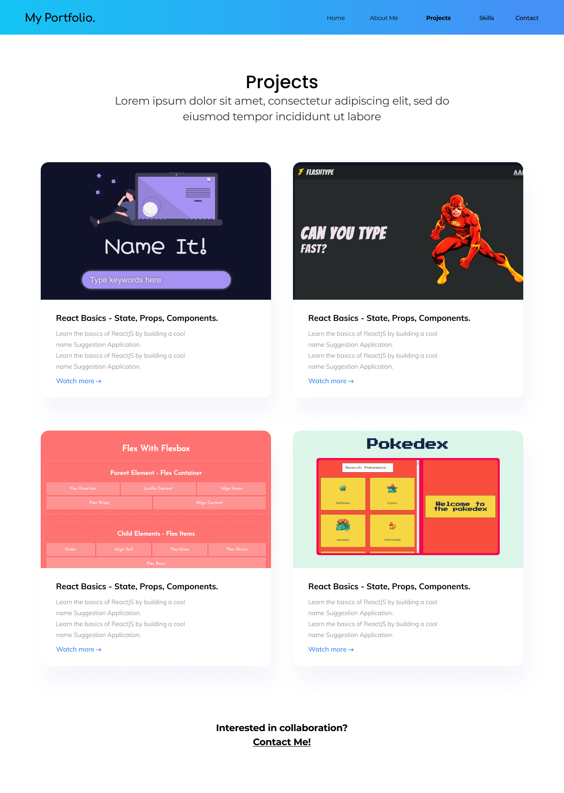

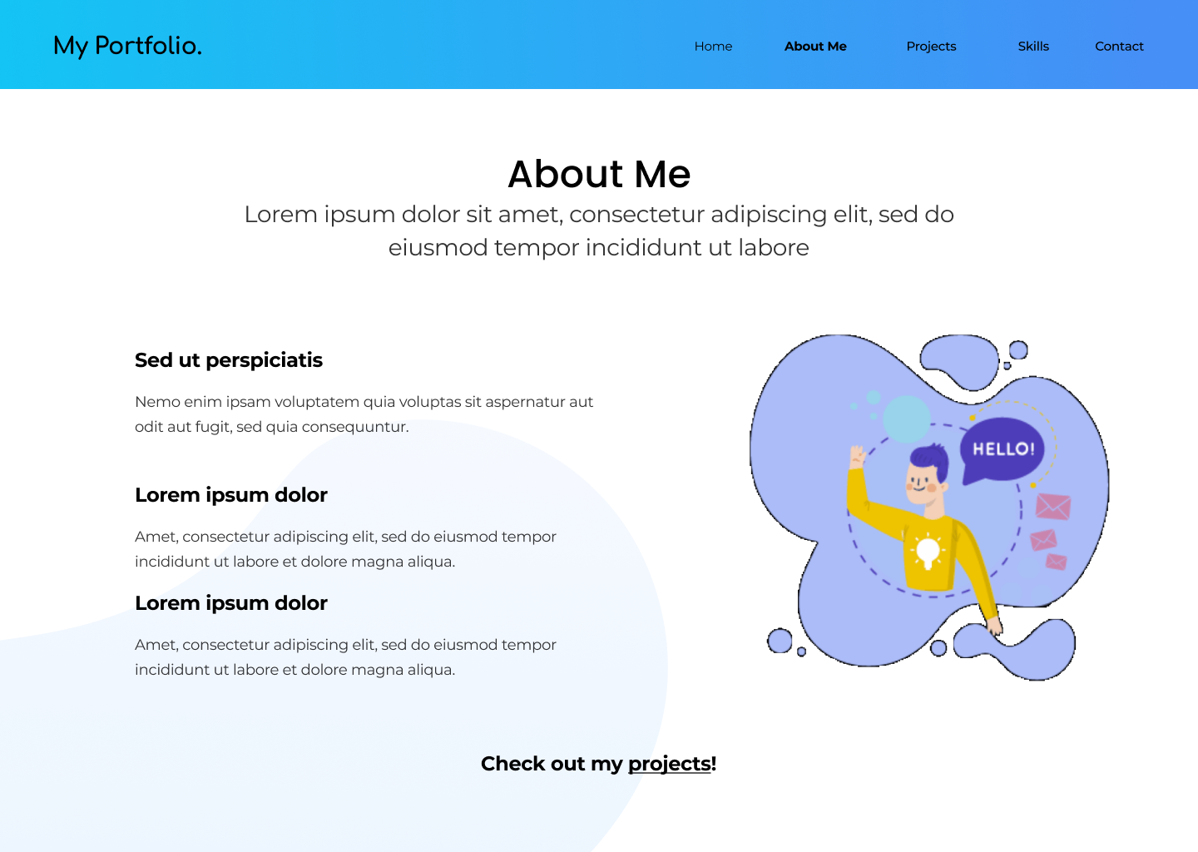

Slide 27
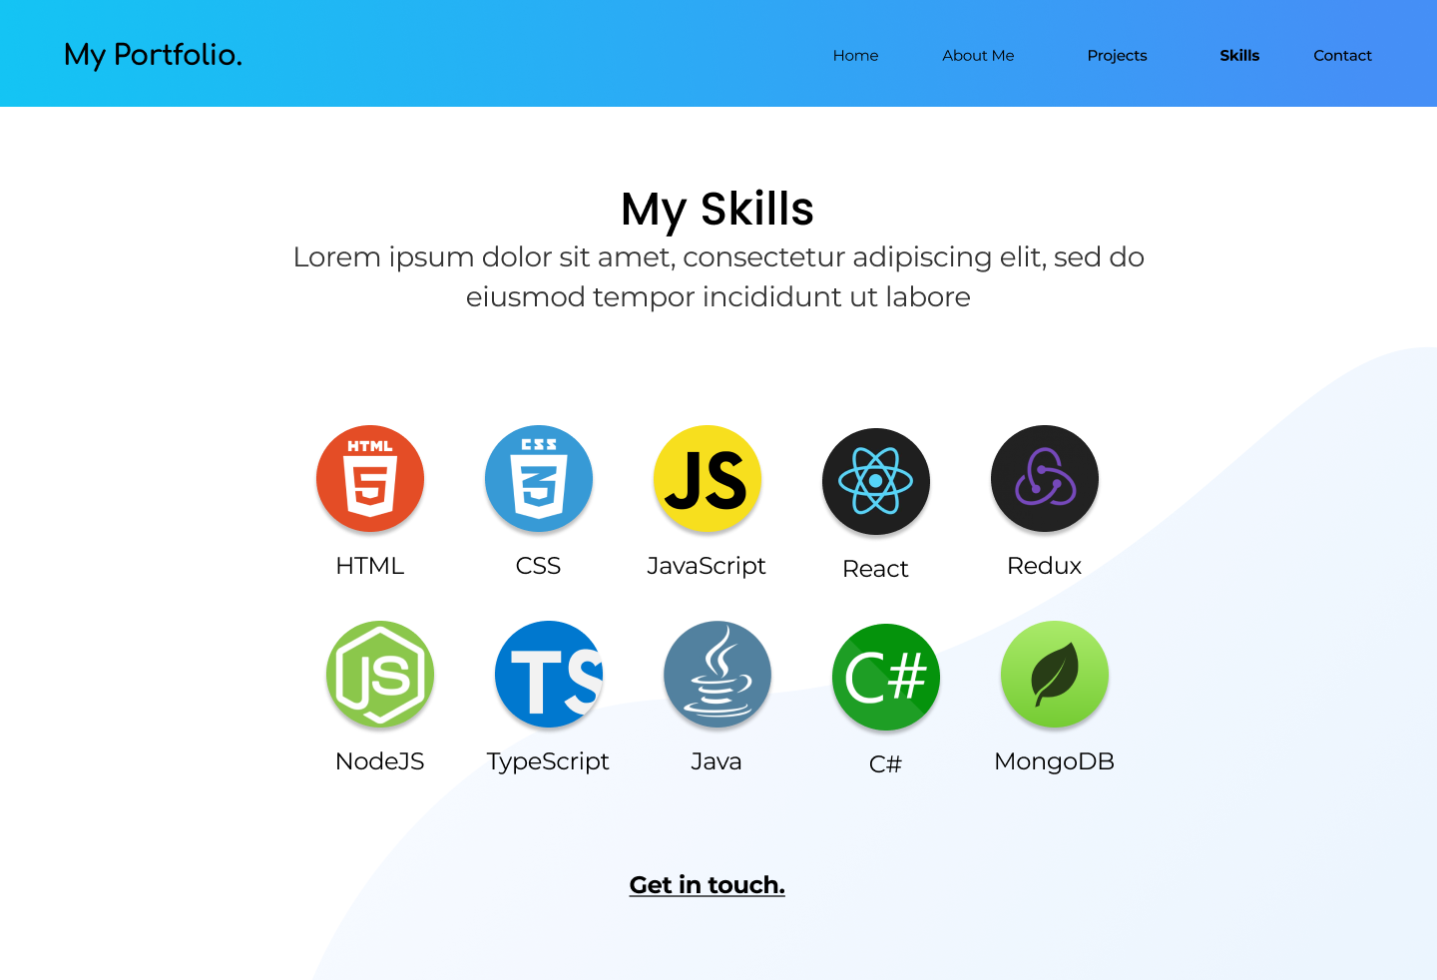
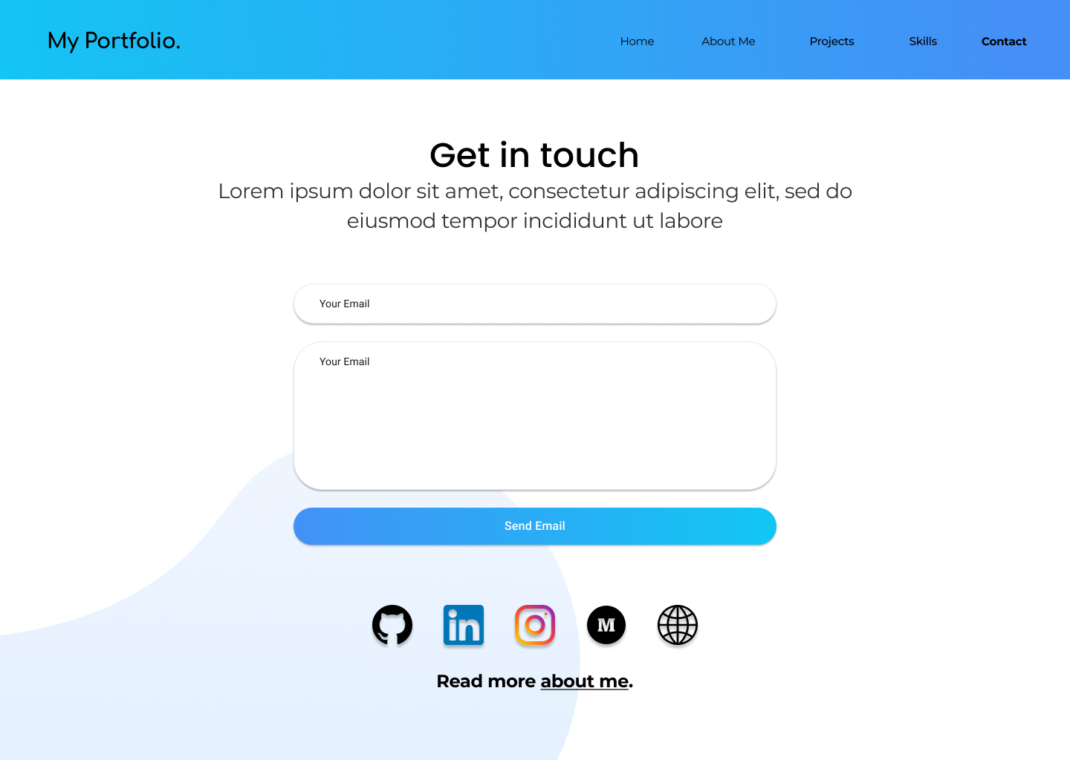

Slide 28
Section 2: understanding the react router

Slide 29
Let’s set up our app
npx create-react-app portfolio
npm install react-router-dom
npm install react-burger-menu
theleanprogrammer.com/portfolio-assets.rar

Slide 30
What is react router, and why do we need it?
We wouldn’t always have a “single page” app.
For example –
facebook.com/
facebook.com/profile
facebook.com/messages/12345
Now this can happen in two ways –
Server side
Client side
React router allows us to handle the user navigation (at client side) from our react app.

Slide 31
Server-Side routing
A quick overview

Slide 32
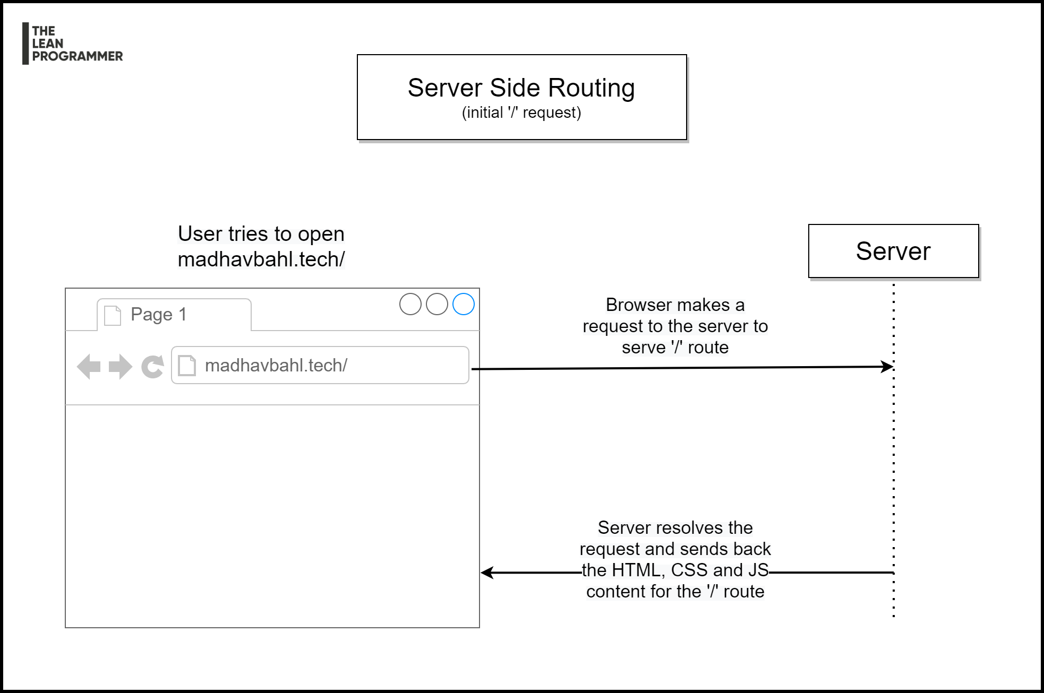

Slide 33
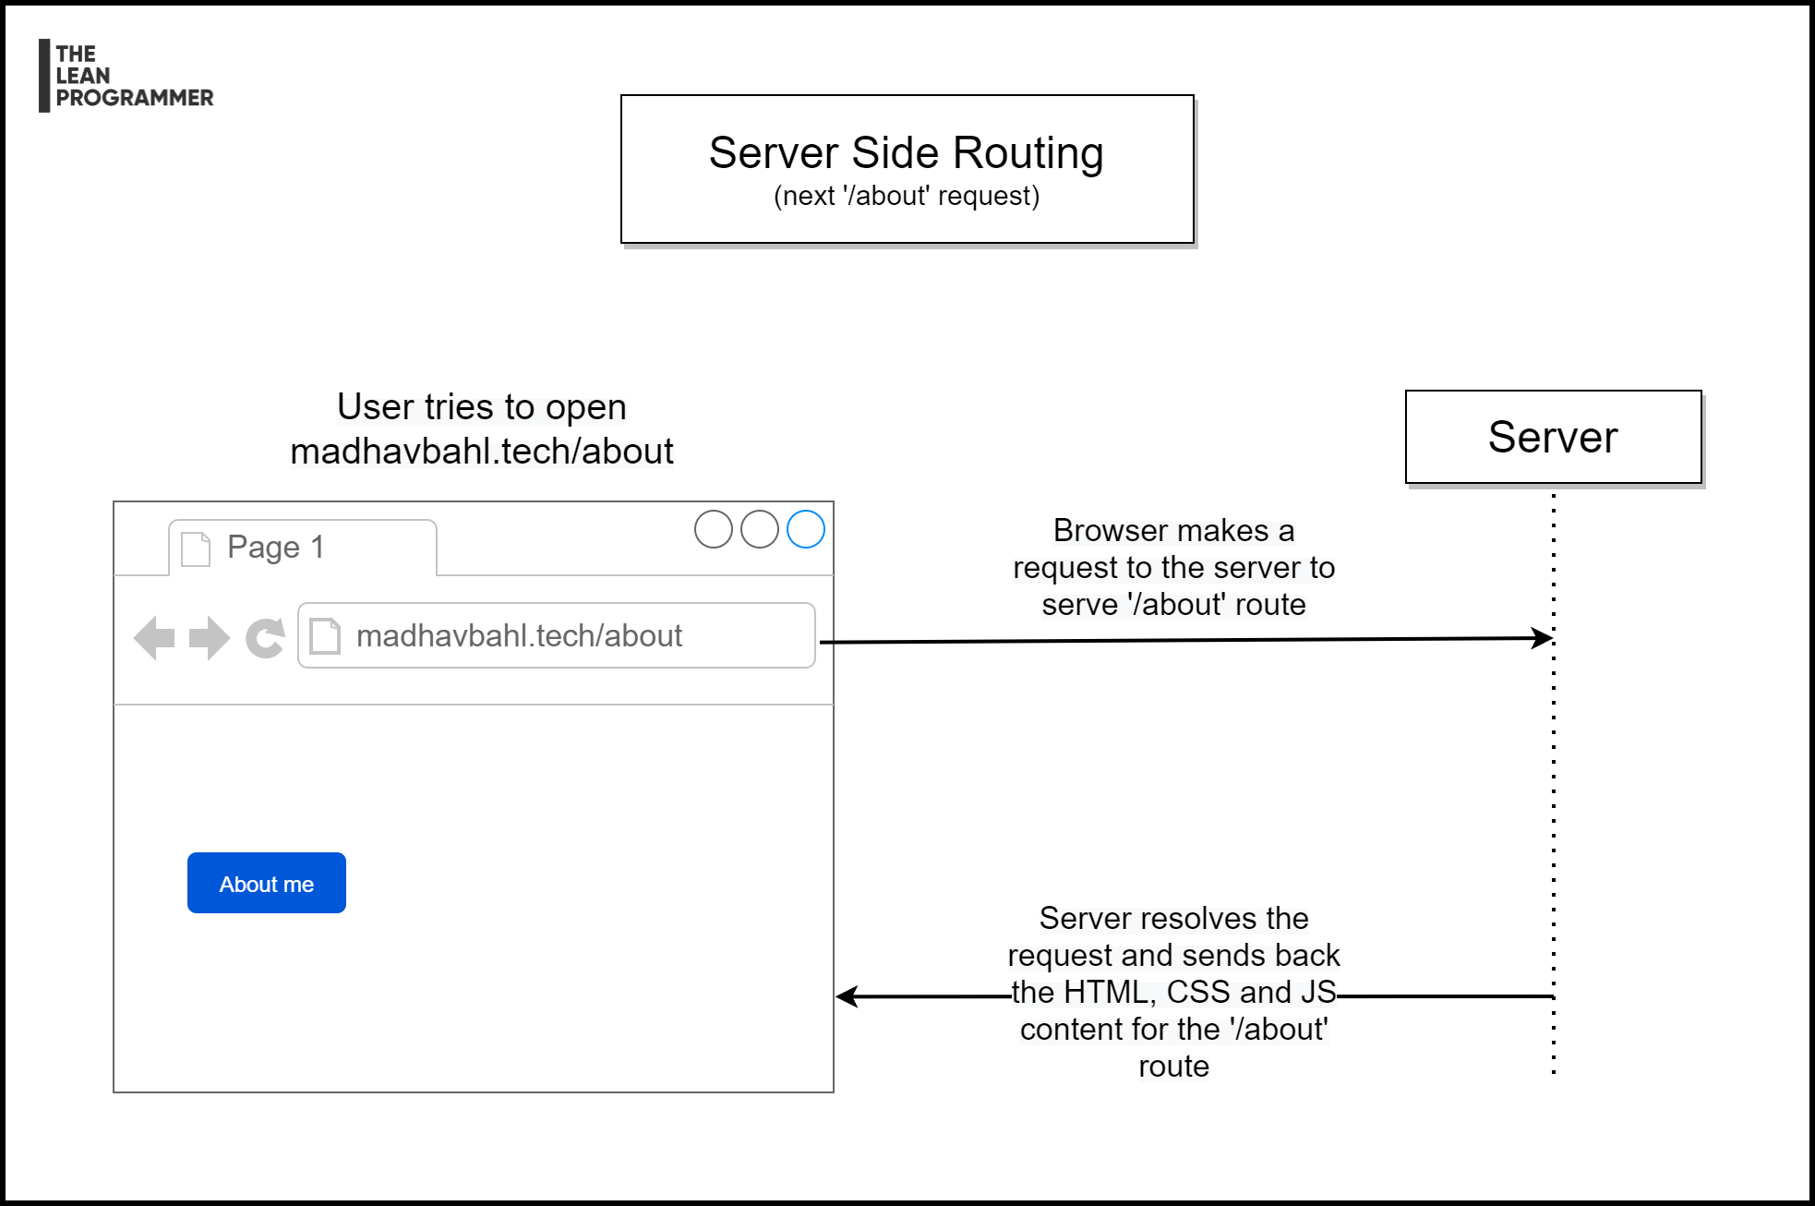

Slide 34
Serve-side routing
A server-side request will cause the whole page to refresh
It will request the data that’s needed for the current page – Not less, not more
This doesn’t mean it’s efficient – e.g. Header/Footer are generally same, yet they will be loaded again.
Deployment is sometimes easier (since server side routing has been the standard since a long time)
If not optimized, full page render can be expensive

Slide 35
Client-Side routing
A quick overview

Slide 36
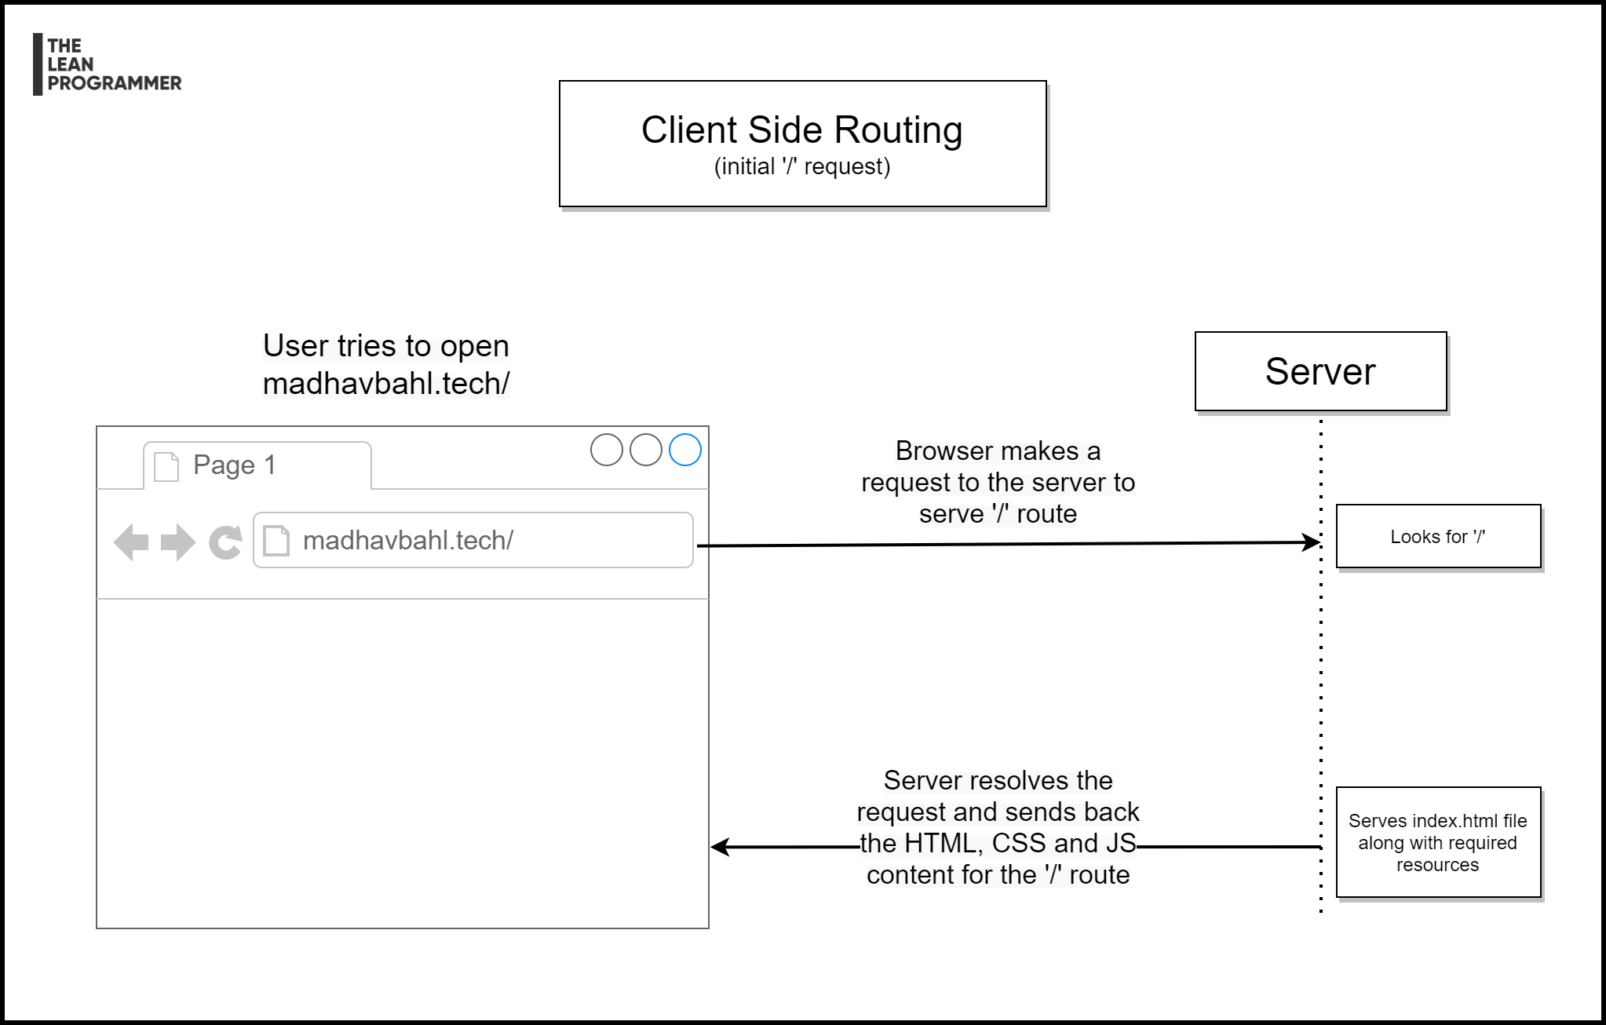

Slide 37
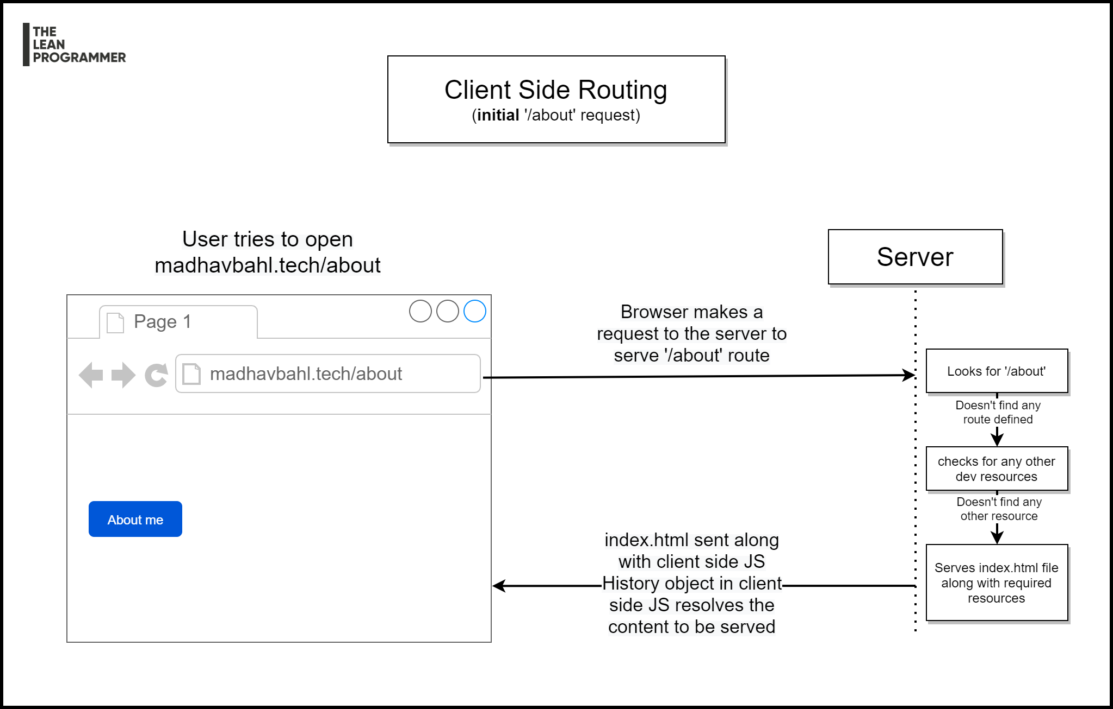

Slide 38
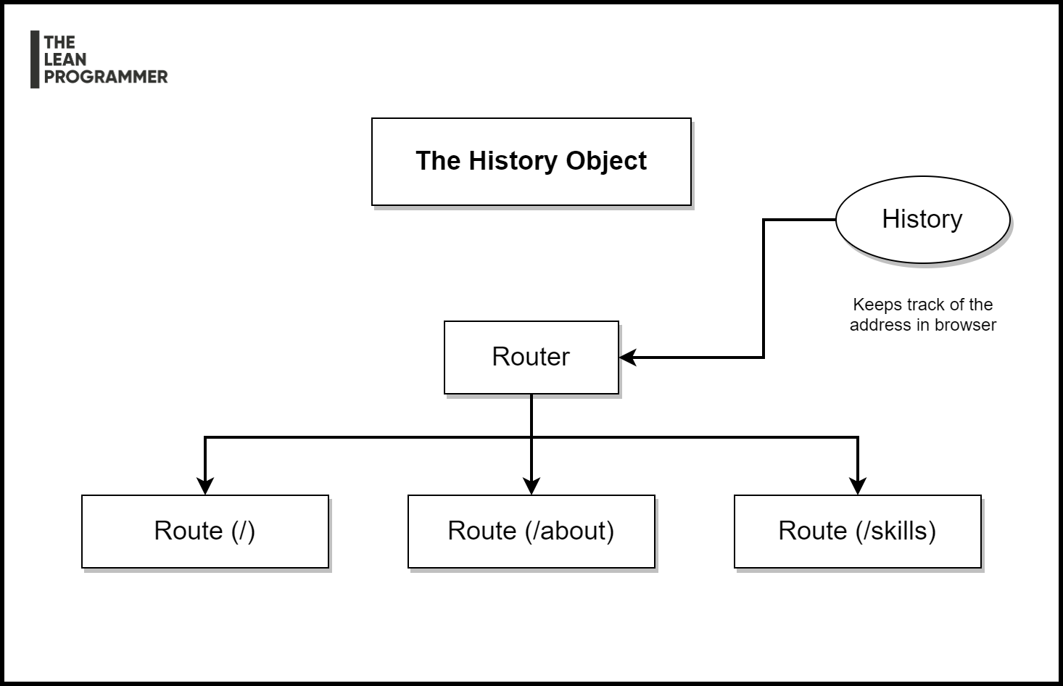

Slide 39
CLIENT-side routing
Routing is internally handled by client side JS
Routing between views looks more smooth as there’s no “full page reload”
Redundant components don’t need to be loaded again and again (e.g. Header/Footer)
Again, this doesn’t mean it’s more efficient, since most of the client side JS is loaded on the first request, so the initial loading time can be relatively high.
Requires more set-up on client side
Can affect search engine results.

Slide 40
Let’s code out our multi-page app!

Slide 41
When and why do we need ‘exact’?
React router matches the URL route in browser with the routes we define
The match is more like a “contains” check
Therefore, ‘/’ will match with both ‘/’ and ‘/about’
‘/projects’ will match with both ‘/projects’ and ‘projects/25’
To prevent this, we use the ‘exact’ check!

Slide 42
Programmatic navigation
Not every-time the user will specifically click on a button to change the page
For example –
Showing the profile after sign in was successful
Removing the splash screen after (say) 2 seconds
React router also gives us a provision of navigating programmatically!
We can use the history object to go back, or go to a specific page.

Slide 43
Types of routers

Slide 44
1. Browser Router
localhost:3000/about
Everything after the top-level domain is seen as the route
2. Hash Router
localhost:3000/#/about
Everything after the ‘#’ is seen as the route
3. Memory Router
localhost:3000/
Doesn’t use the URL to track the routes

Slide 45
Section 3: understanding the react portals

Slide 46

Where will you add the modal component?
A quick question!

Slide 47
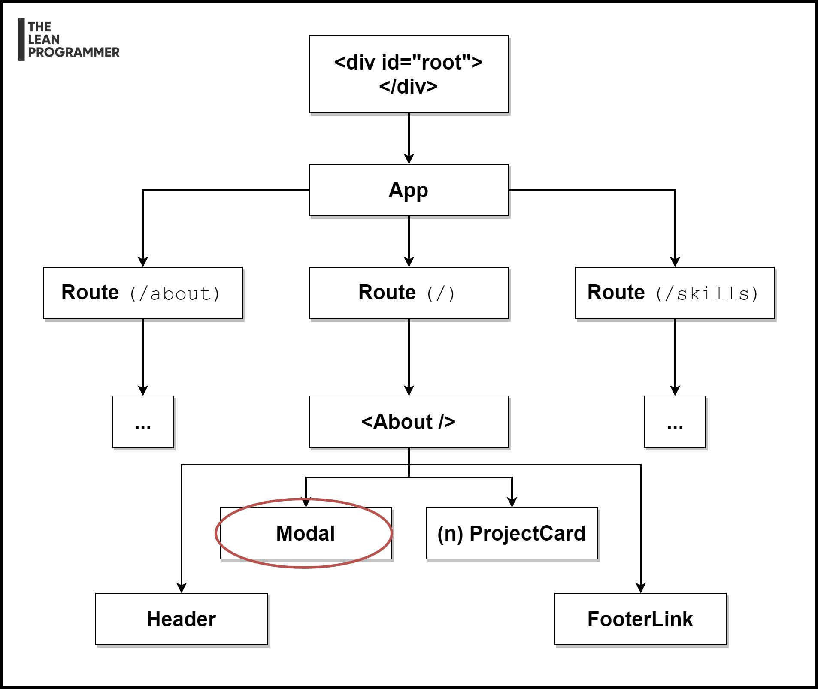
Will it be a child of About?

Slide 48
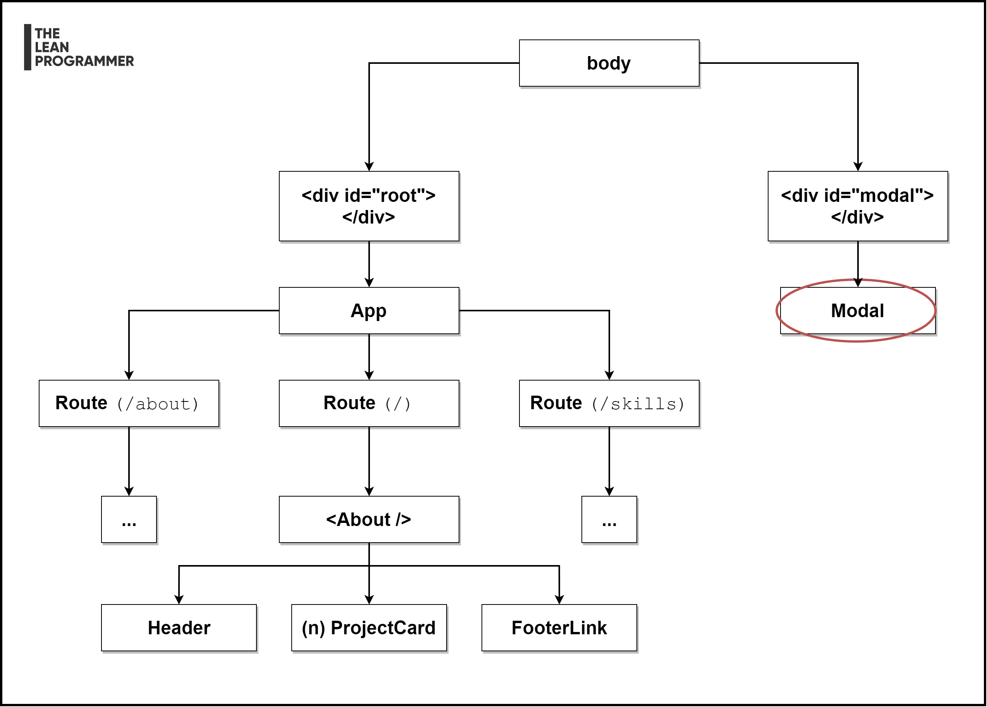
React portals allow us to break this usual flow!

Slide 49

Let’s start coding!

Slide 50
Section 4: implementing the cool designs!

